Slide 1
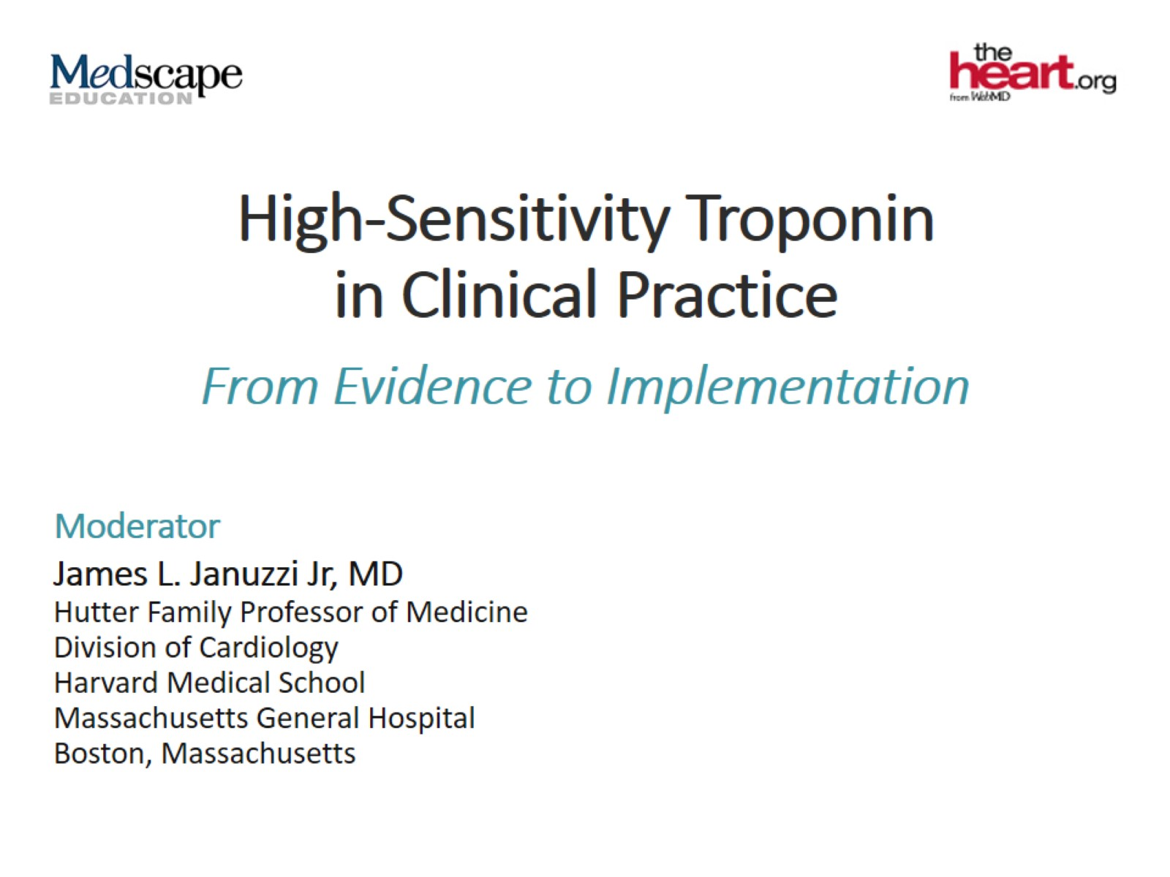
High-Sensitivity Troponin in Clinical Practice

Slide 2
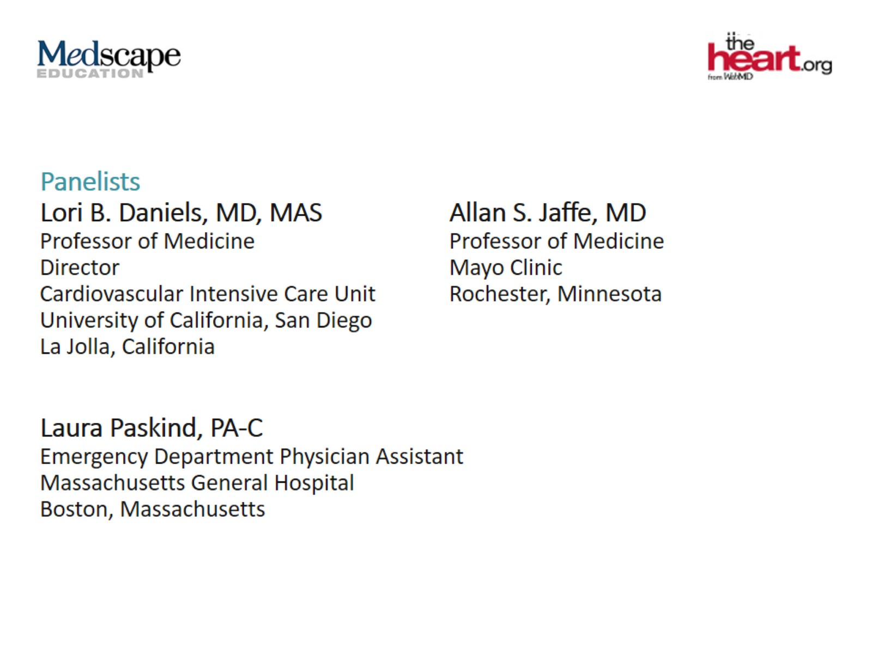

Slide 3
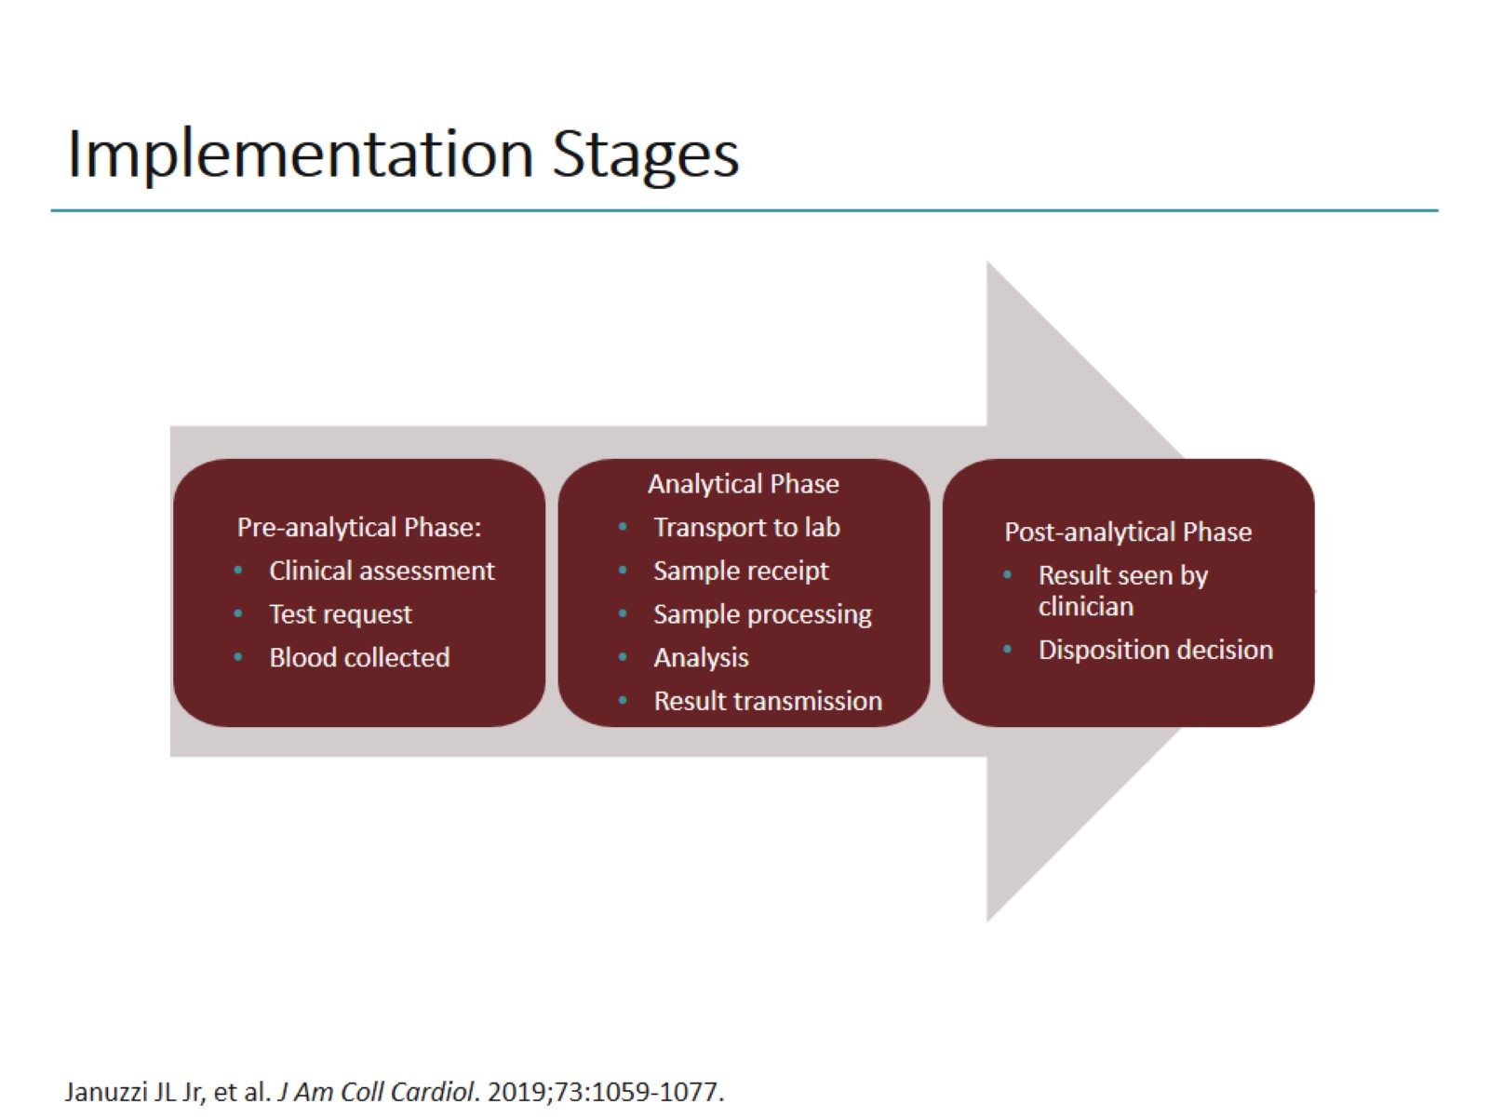
Implementation Stages

Slide 4
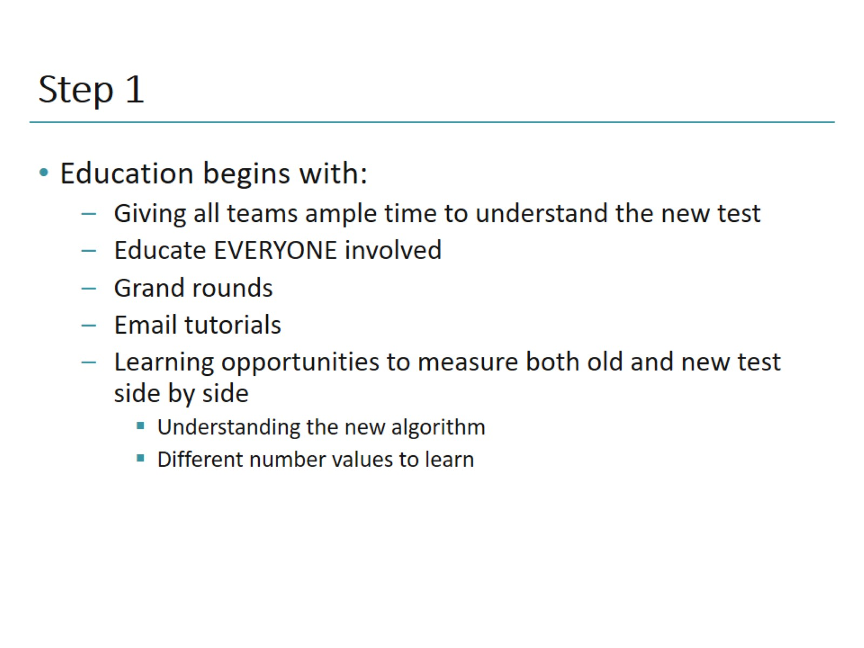
Step 1

Slide 5
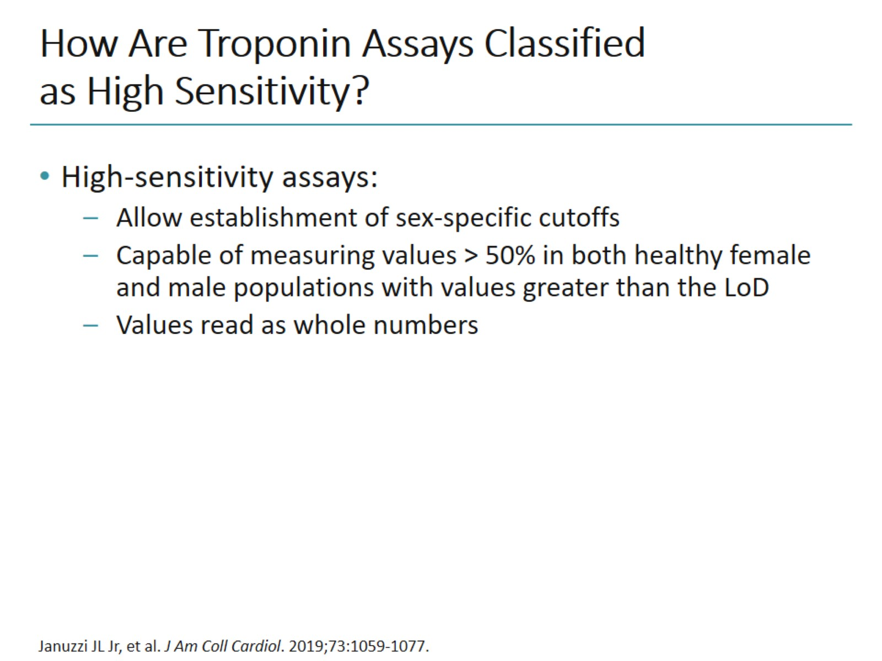
How Are Troponin Assays Classified as High Sensitivity?

Slide 6
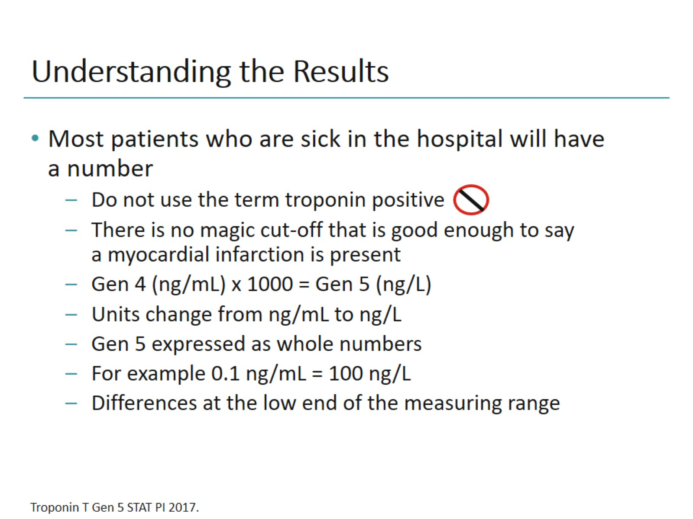
Understanding the Results

Slide 7
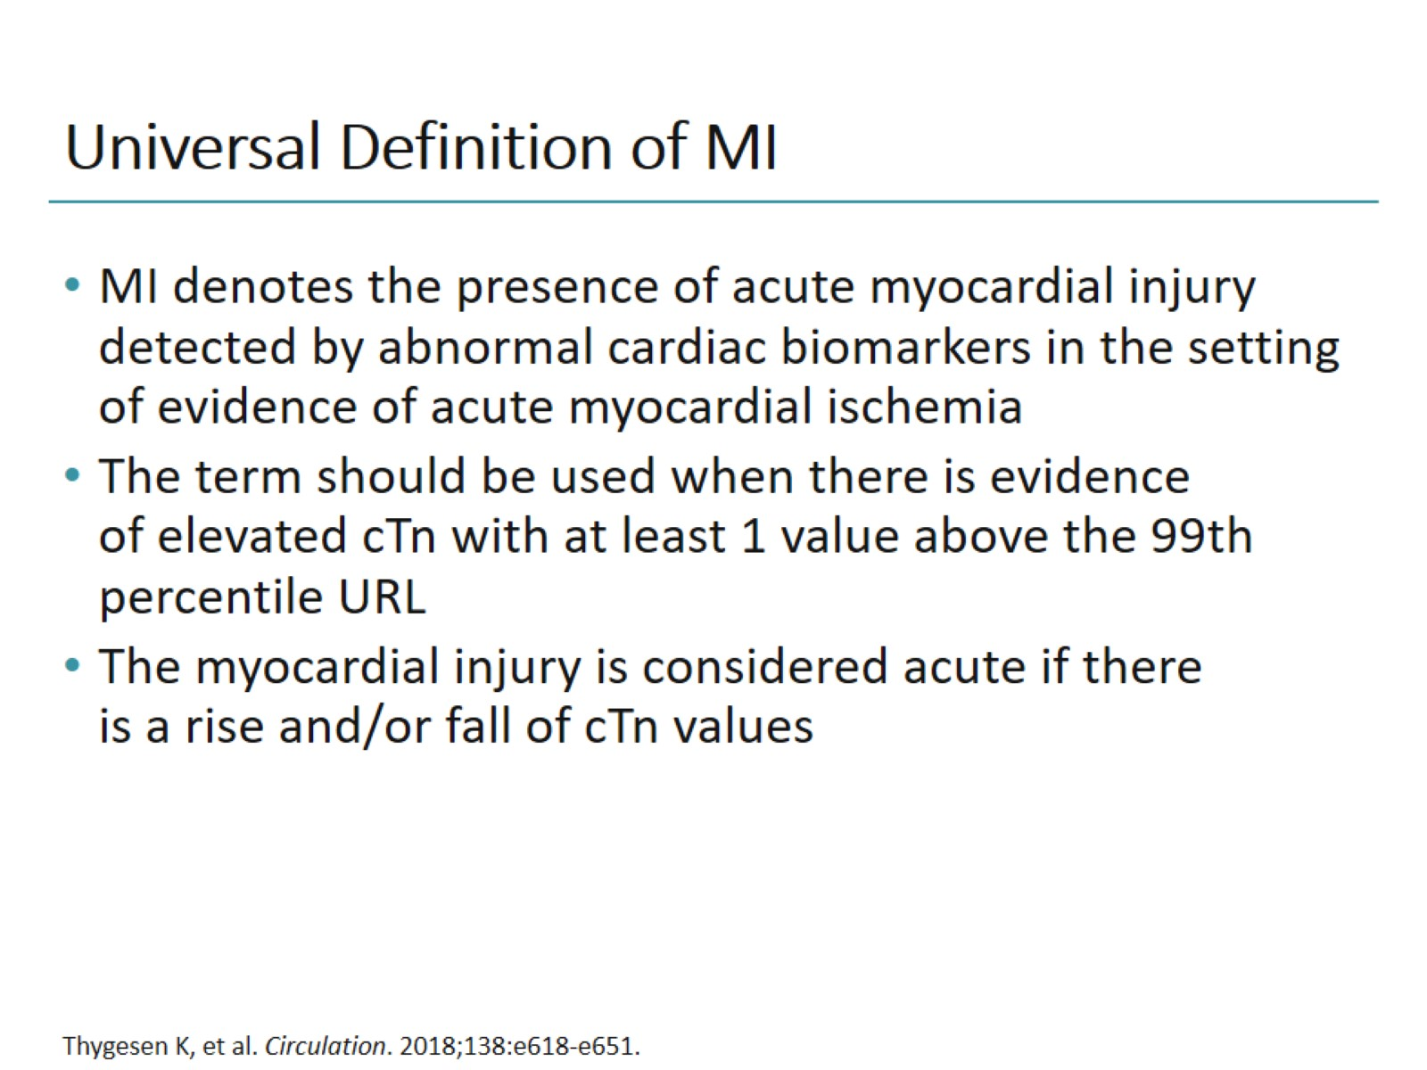
Universal Definition of MI

Slide 8
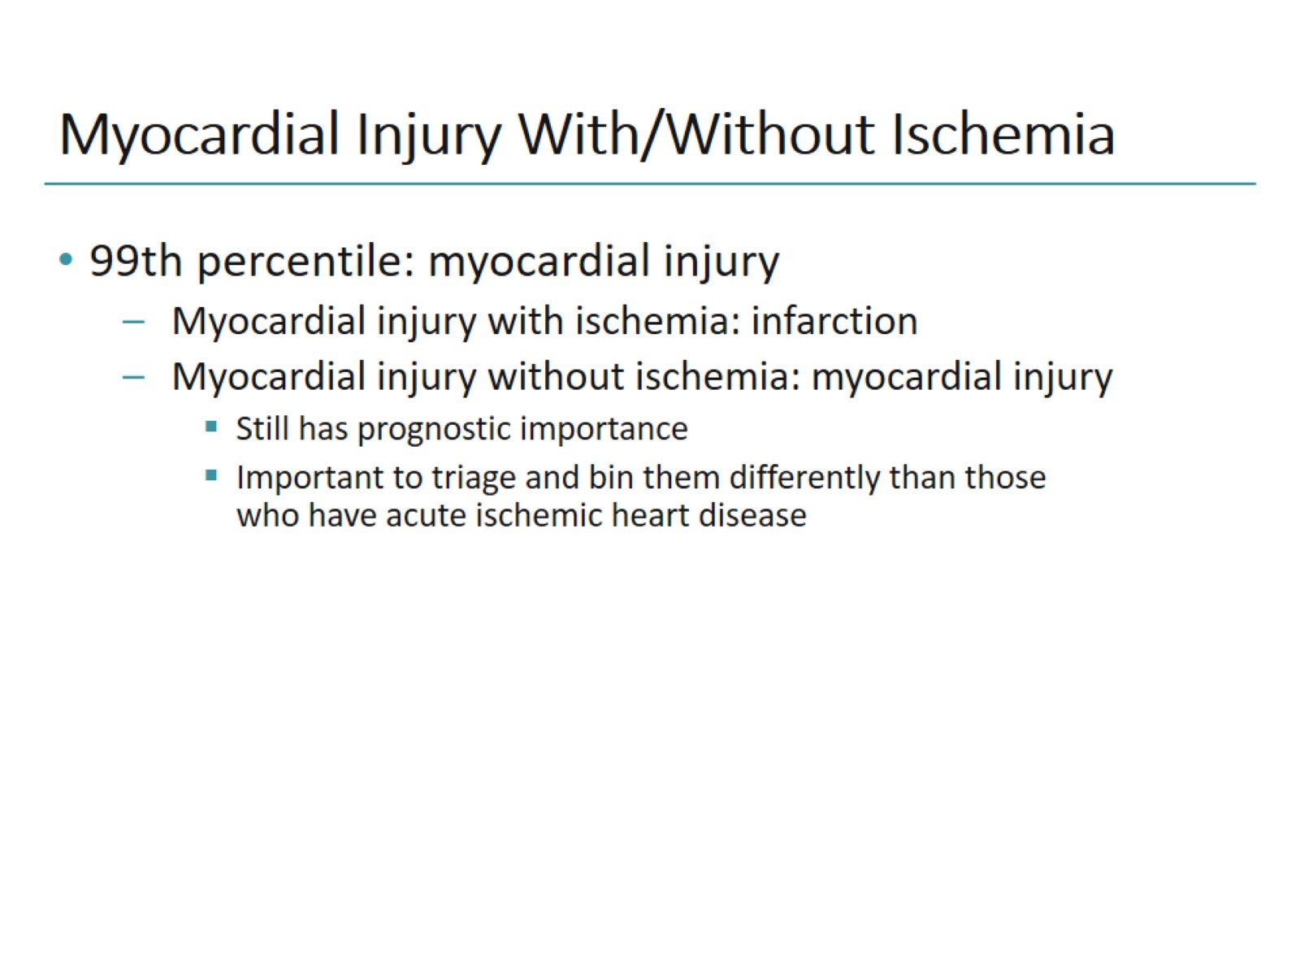
Myocardial Injury With/Without Ischemia

Slide 9
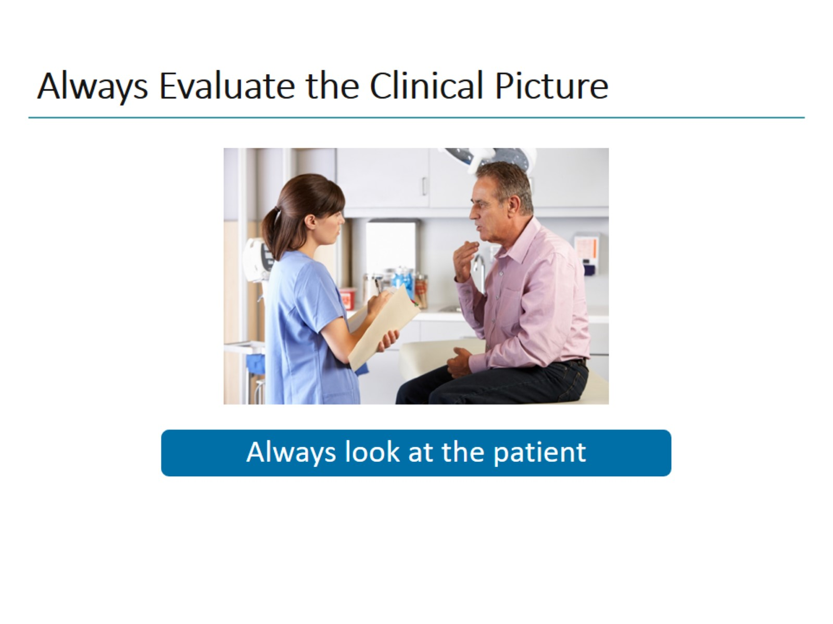
Always Evaluate the Clinical Picture

Slide 10
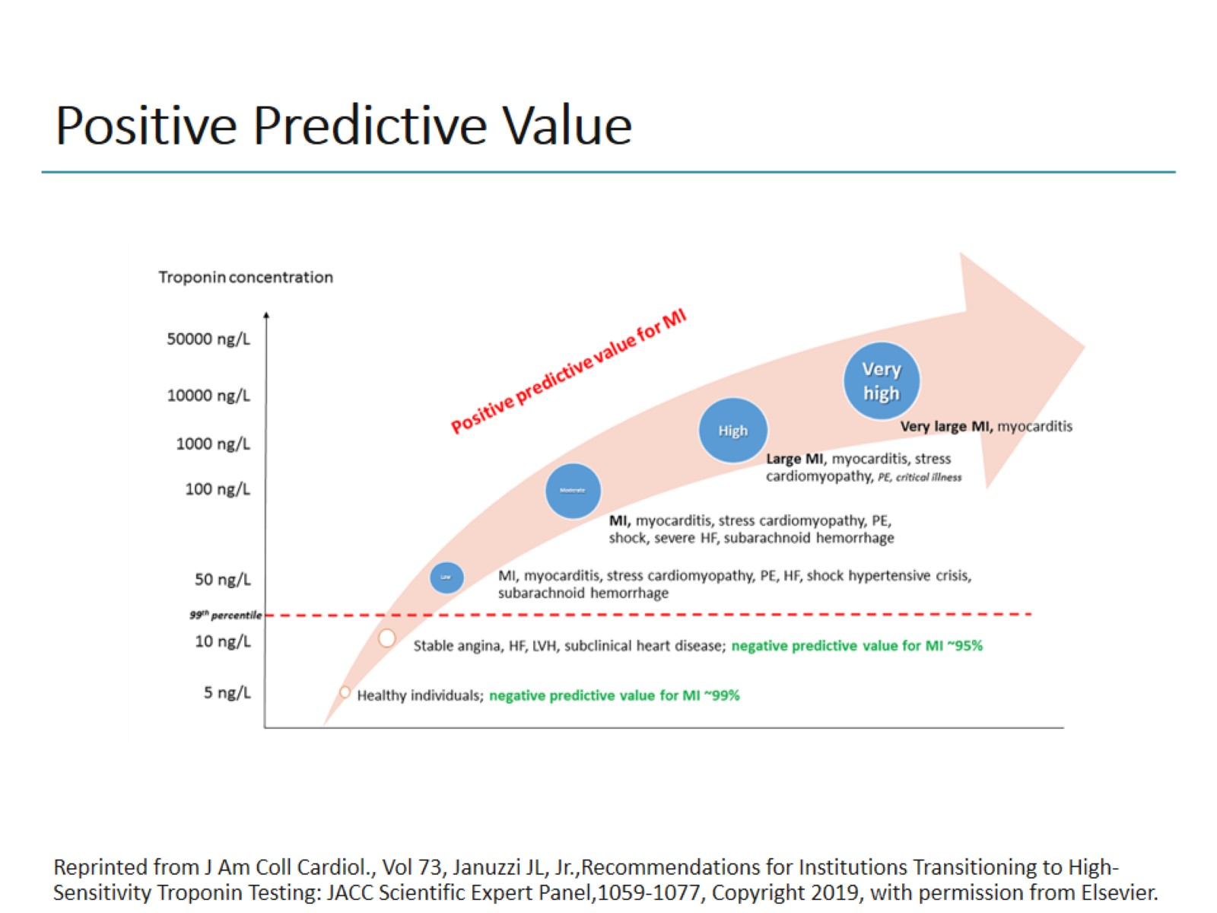
Positive Predictive Value

Slide 11
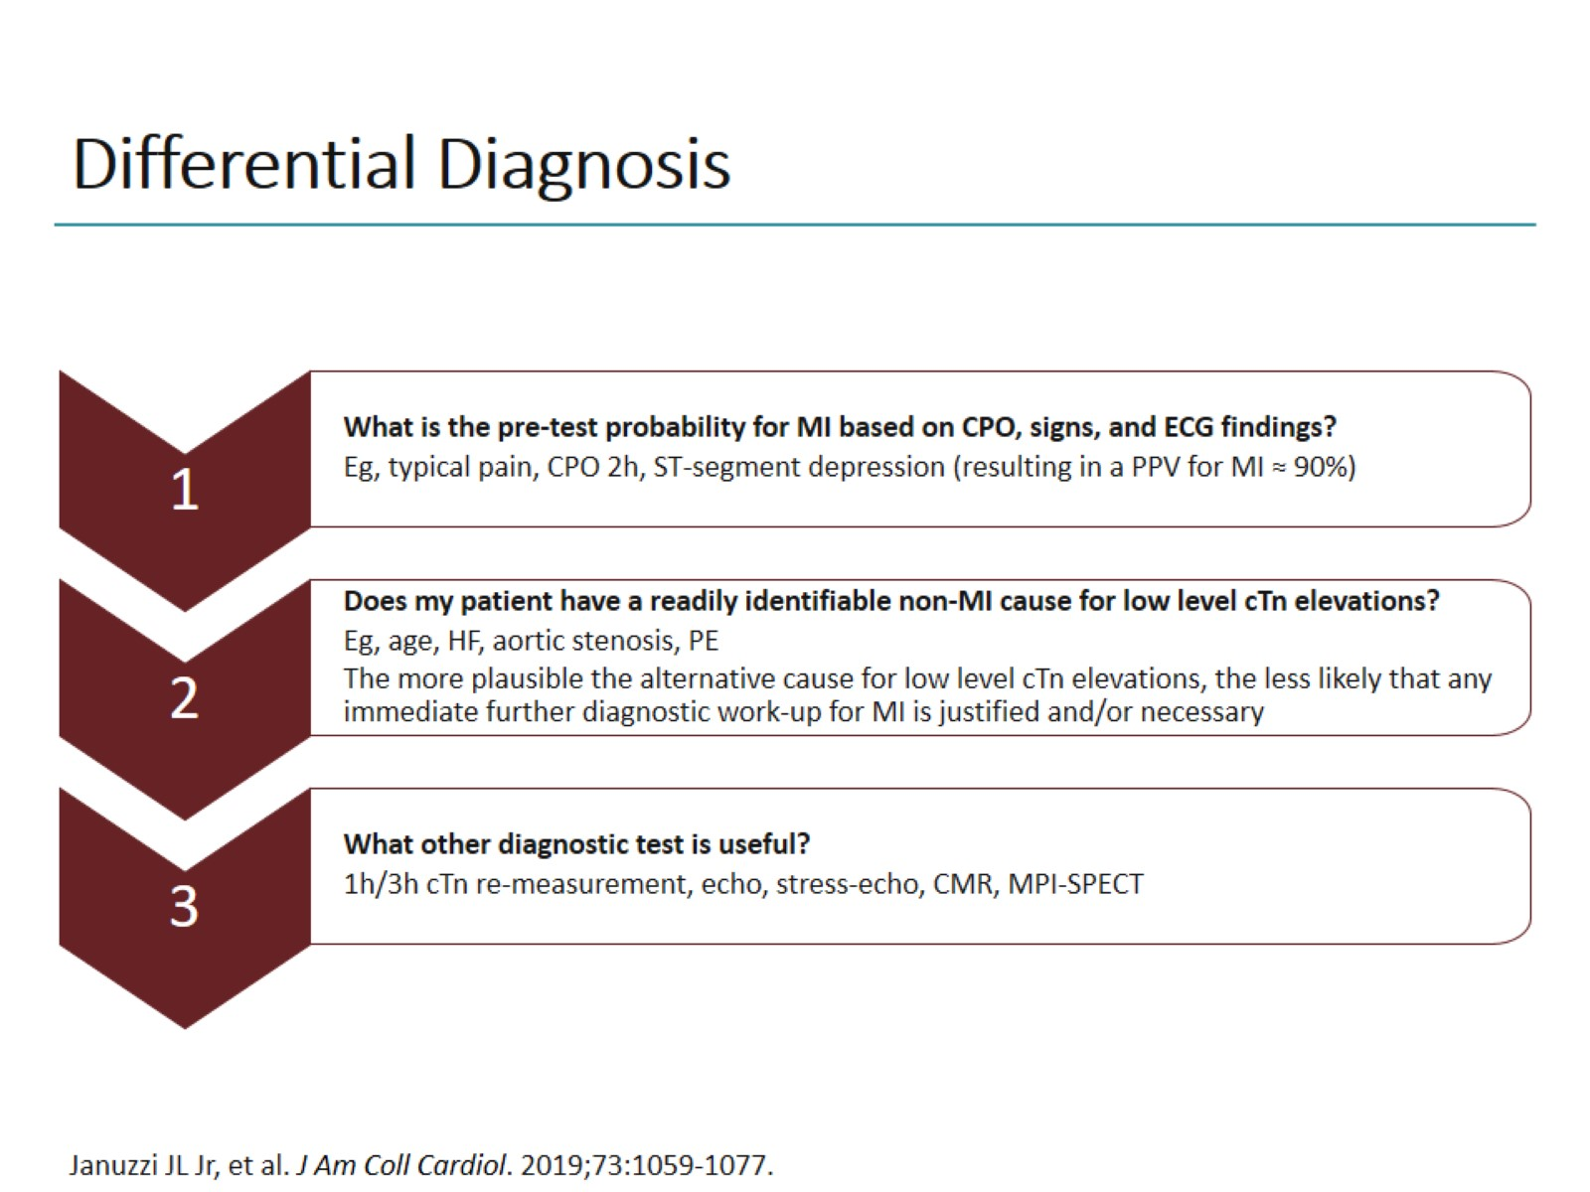
Differential Diagnosis

Slide 12
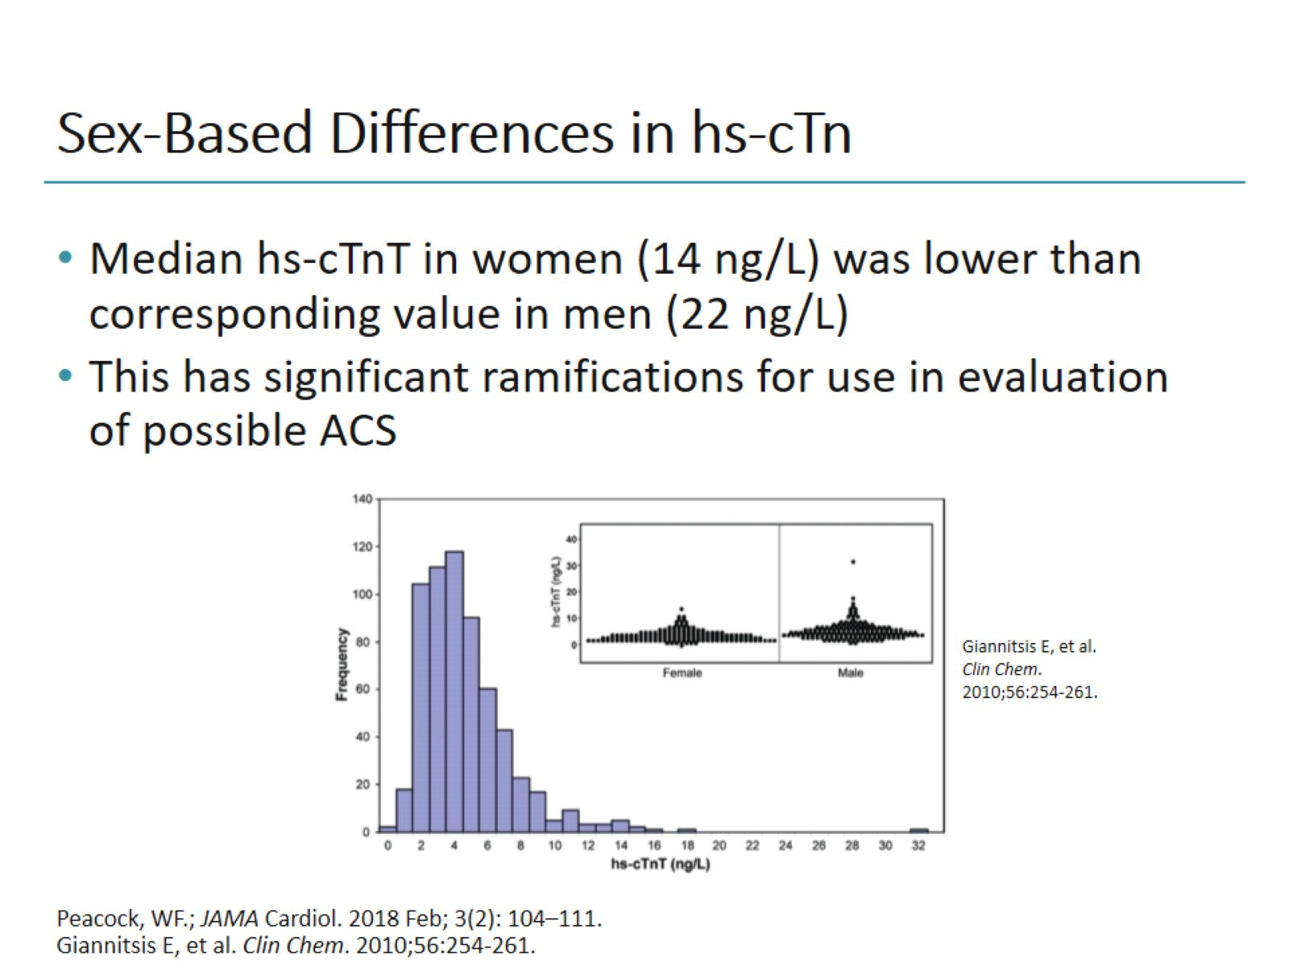
Sex-Based Differences in hs-cTn

Slide 13
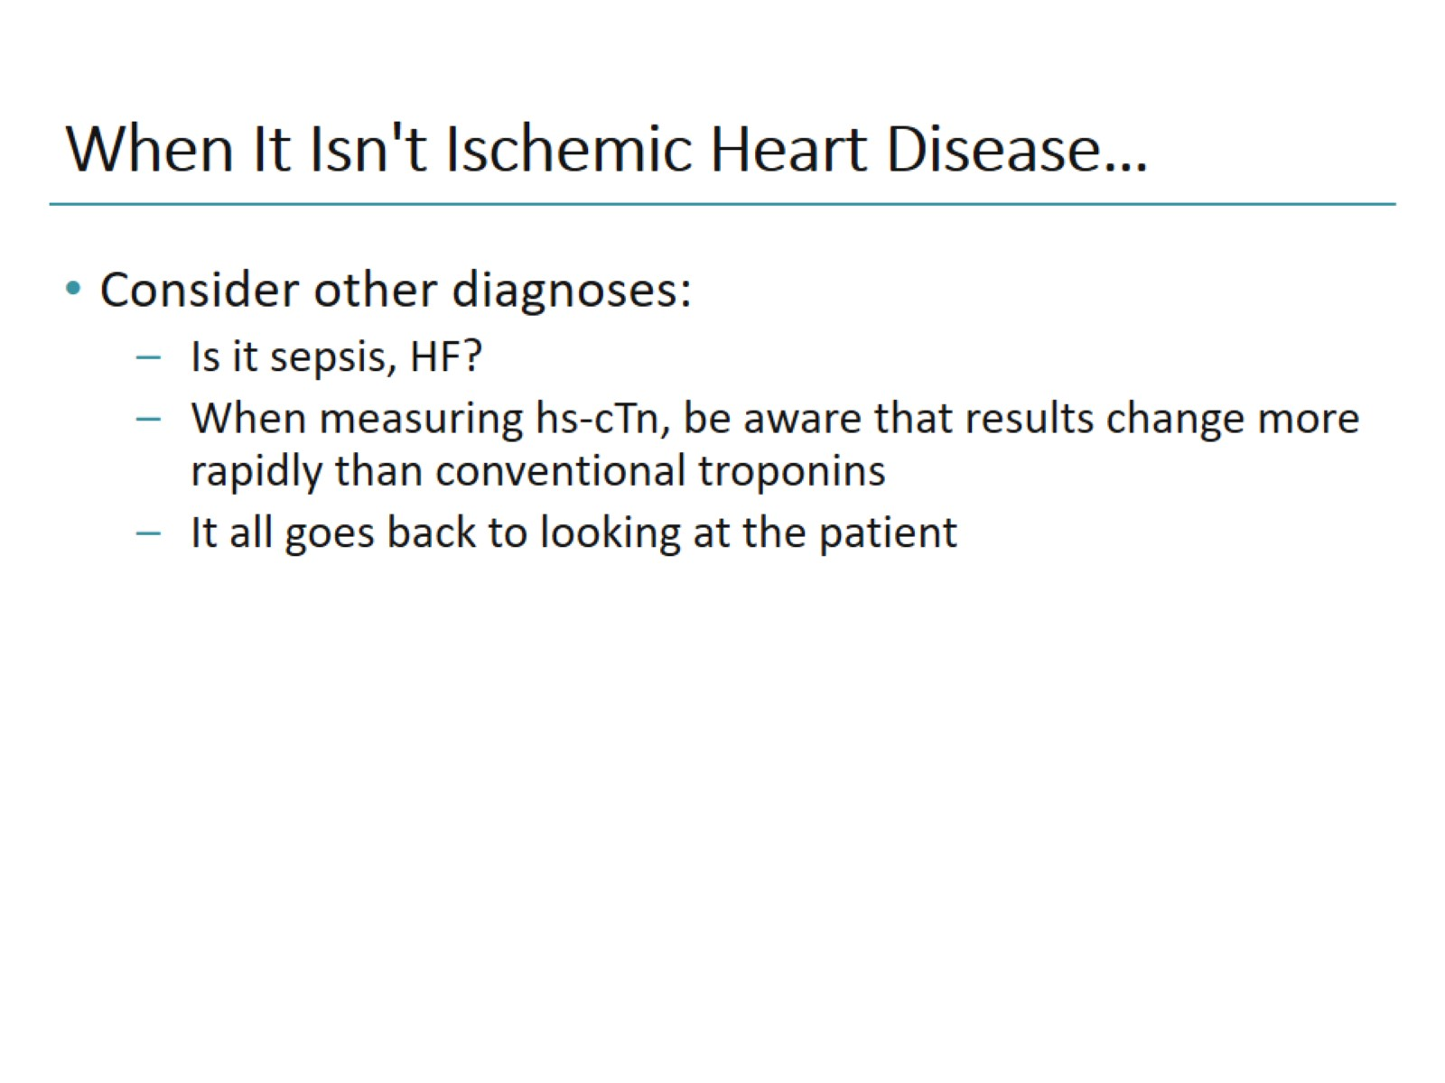
When It Isn't Ischemic Heart Disease…

Slide 14
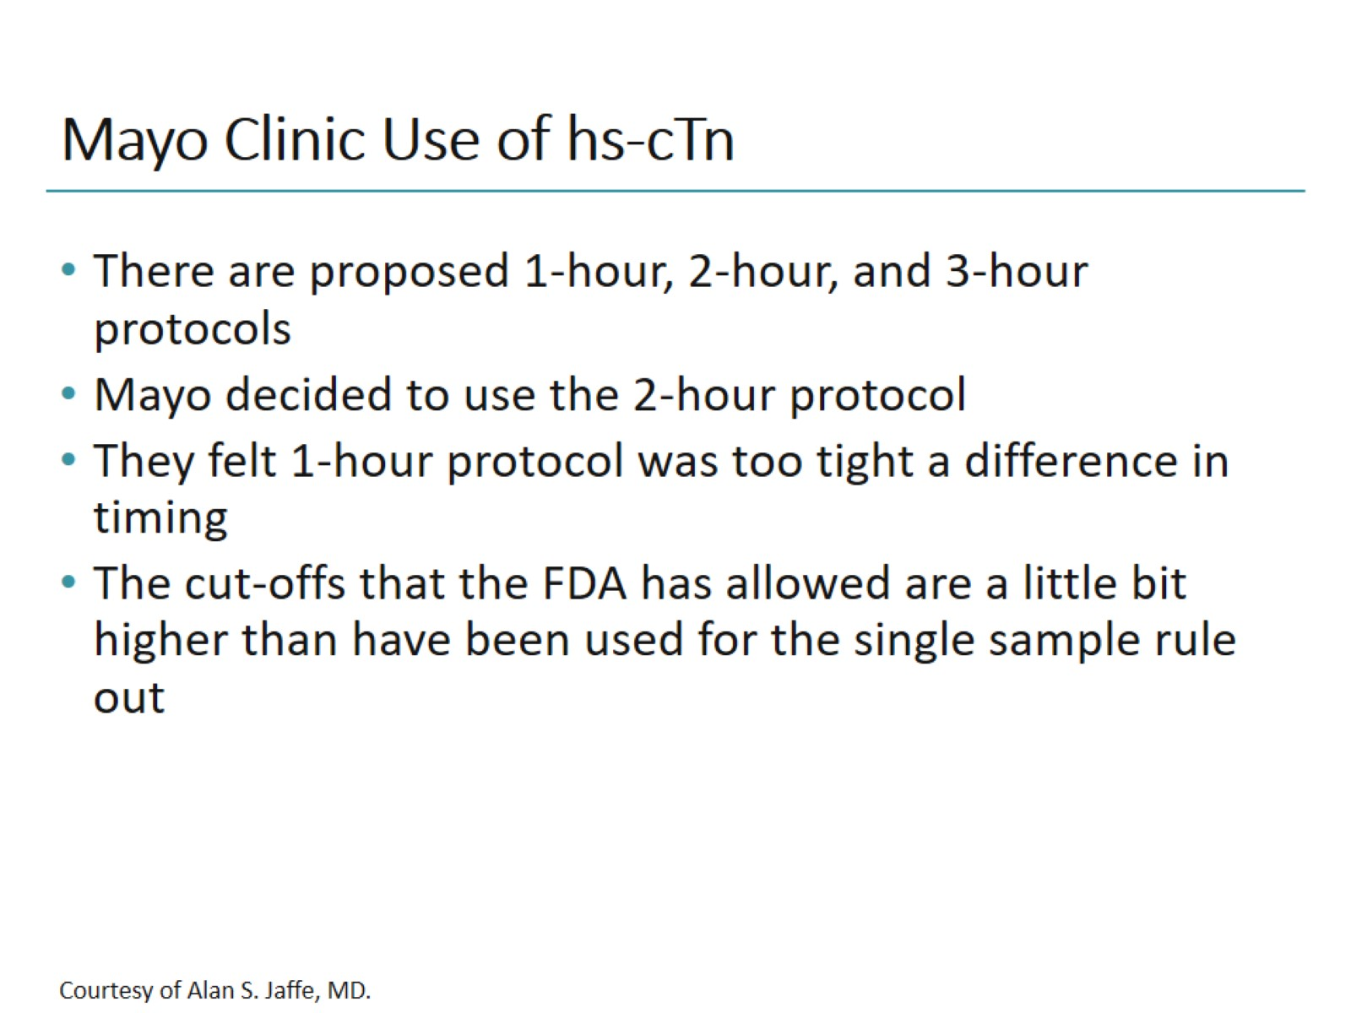
Mayo Clinic Use of hs-cTn

Slide 15
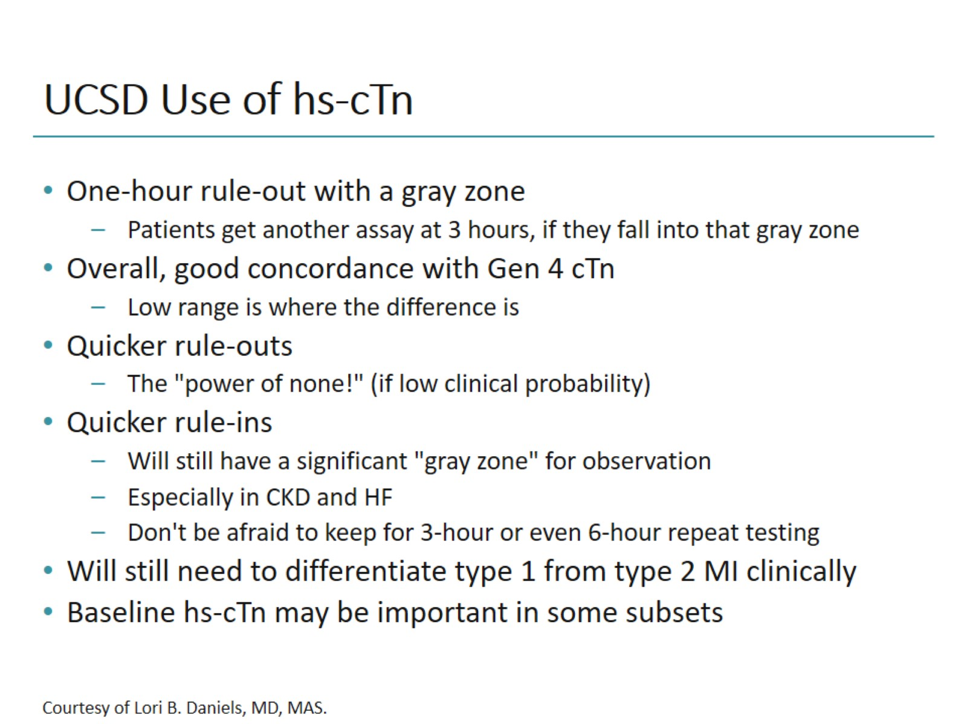
UCSD Use of hs-cTn

Slide 16
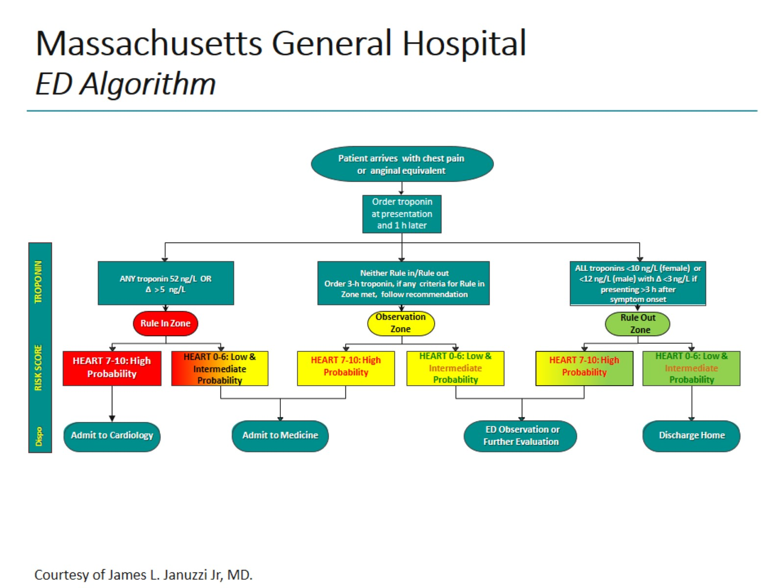
Massachusetts General Hospital ED Algorithm

Slide 17
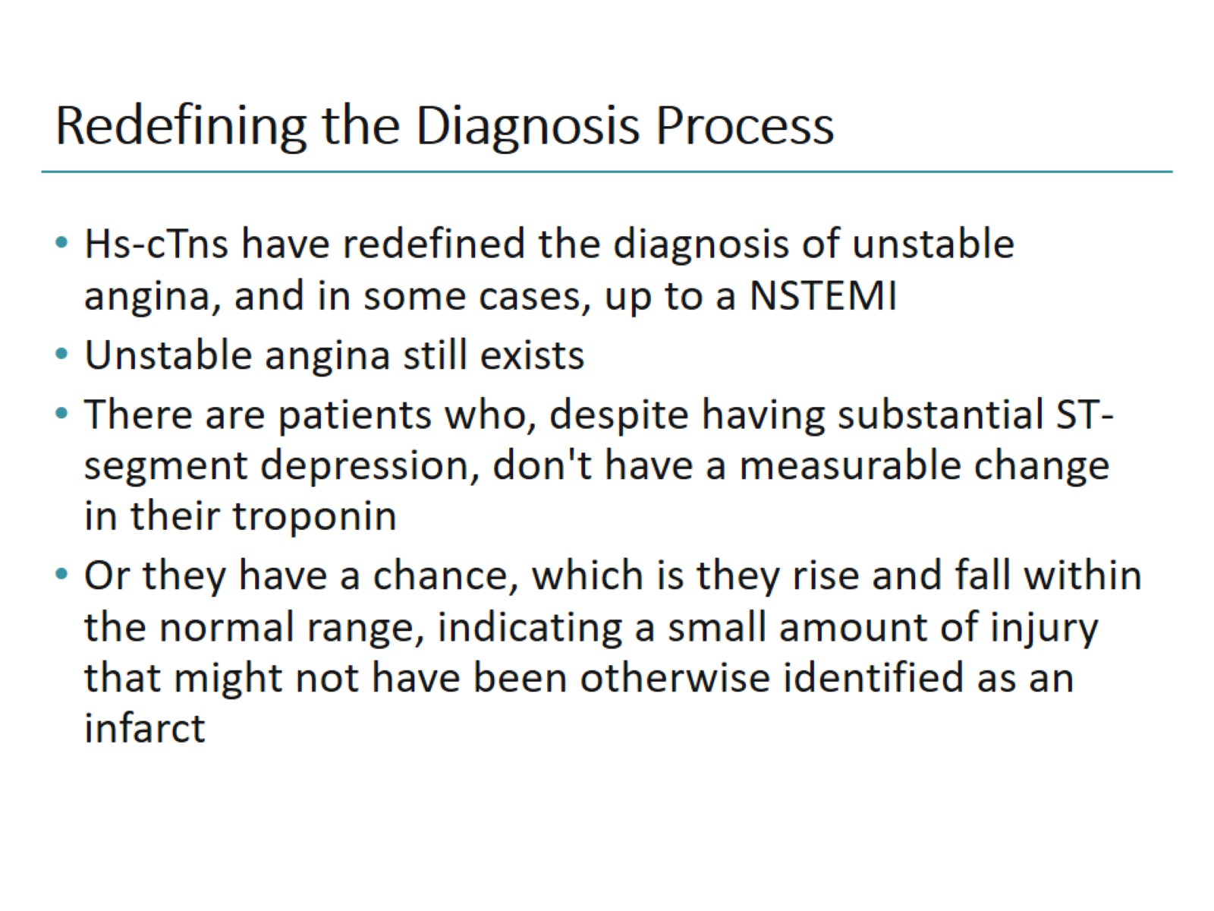
Redefining the Diagnosis Process

Slide 18
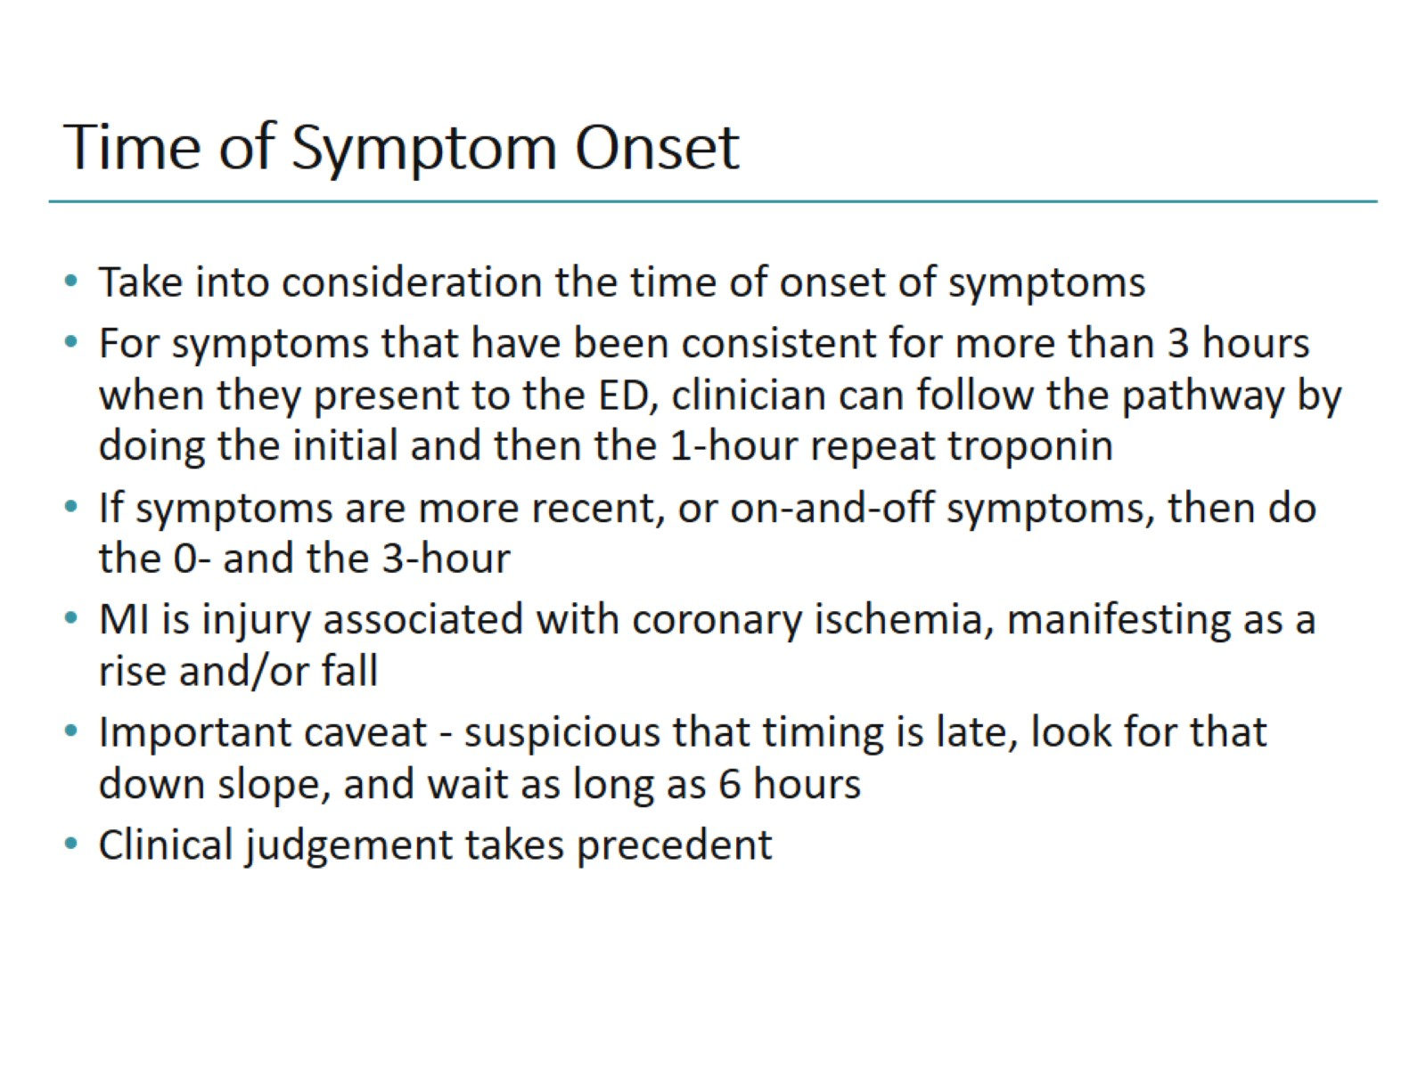
Time of Symptom Onset

Slide 19
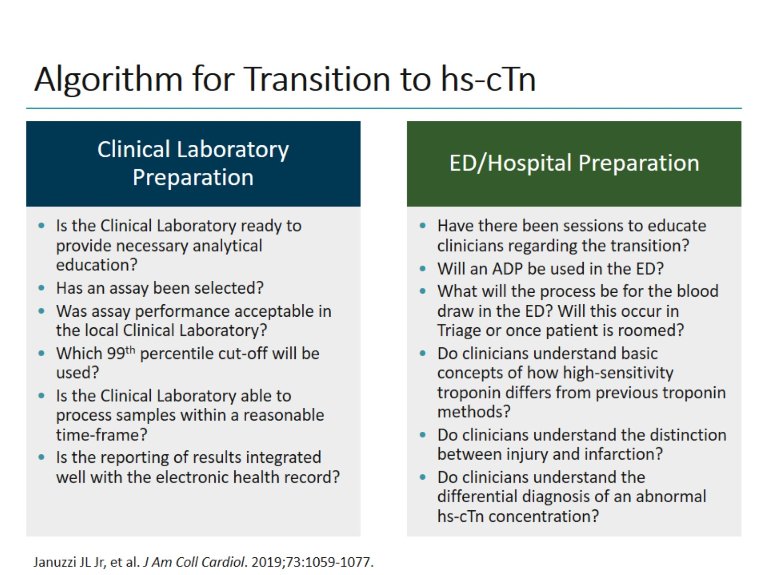
Algorithm for Transition to hs-cTn

Slide 20
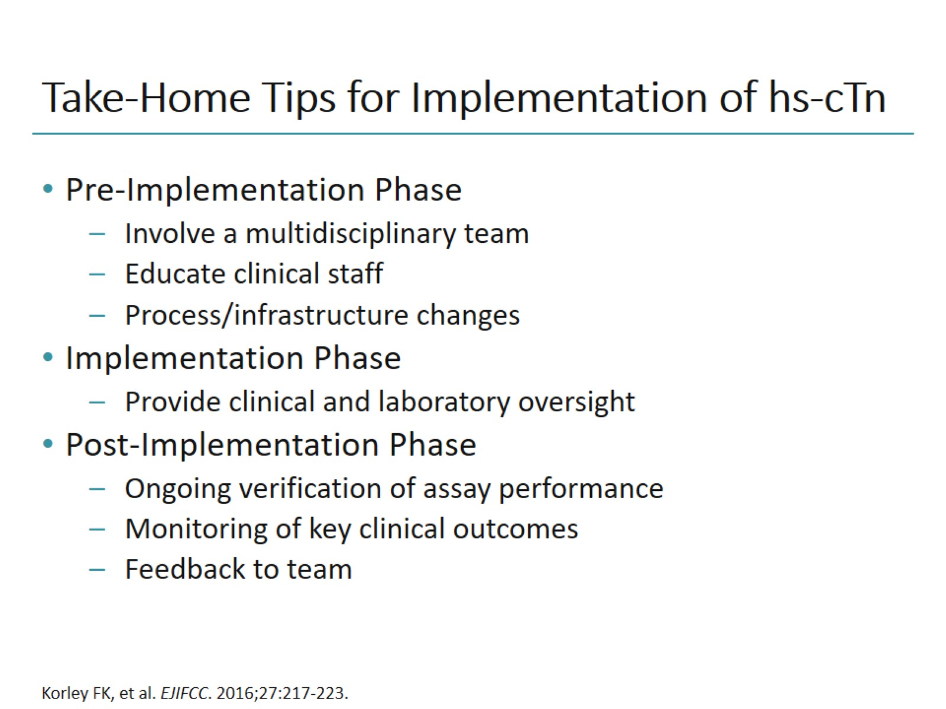
Take-Home Tips for Implementation of hs-cTn

Slide 21
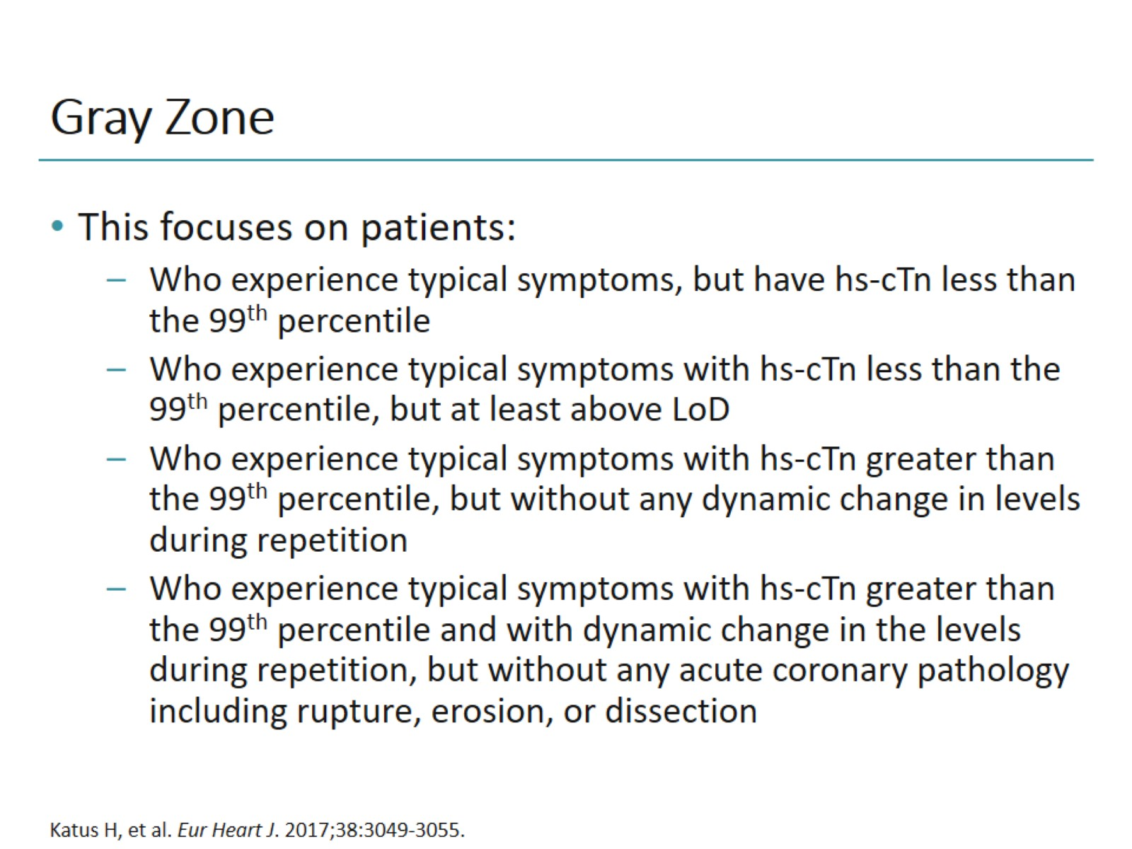
Gray Zone

Slide 22
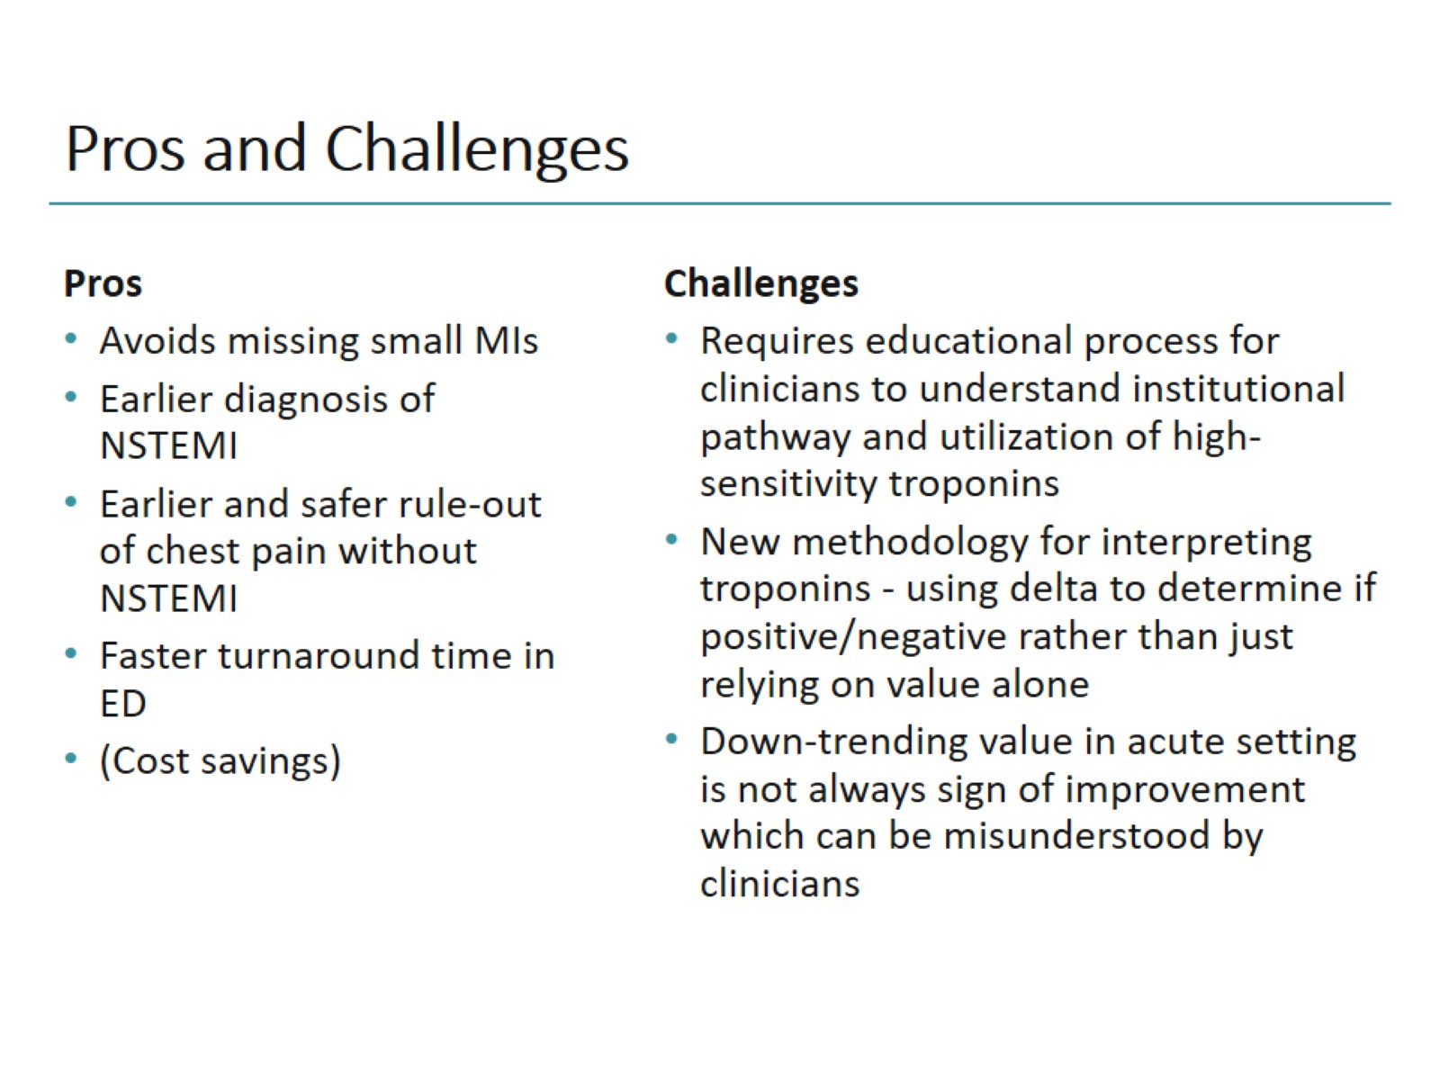
Pros and Challenges

Slide 23
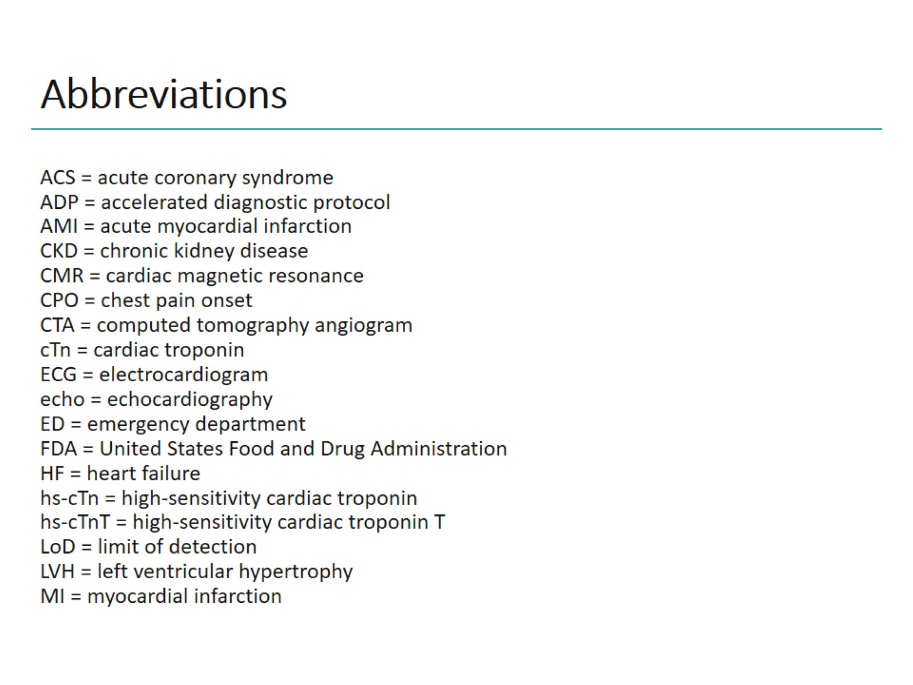
Abbreviations

Slide 24
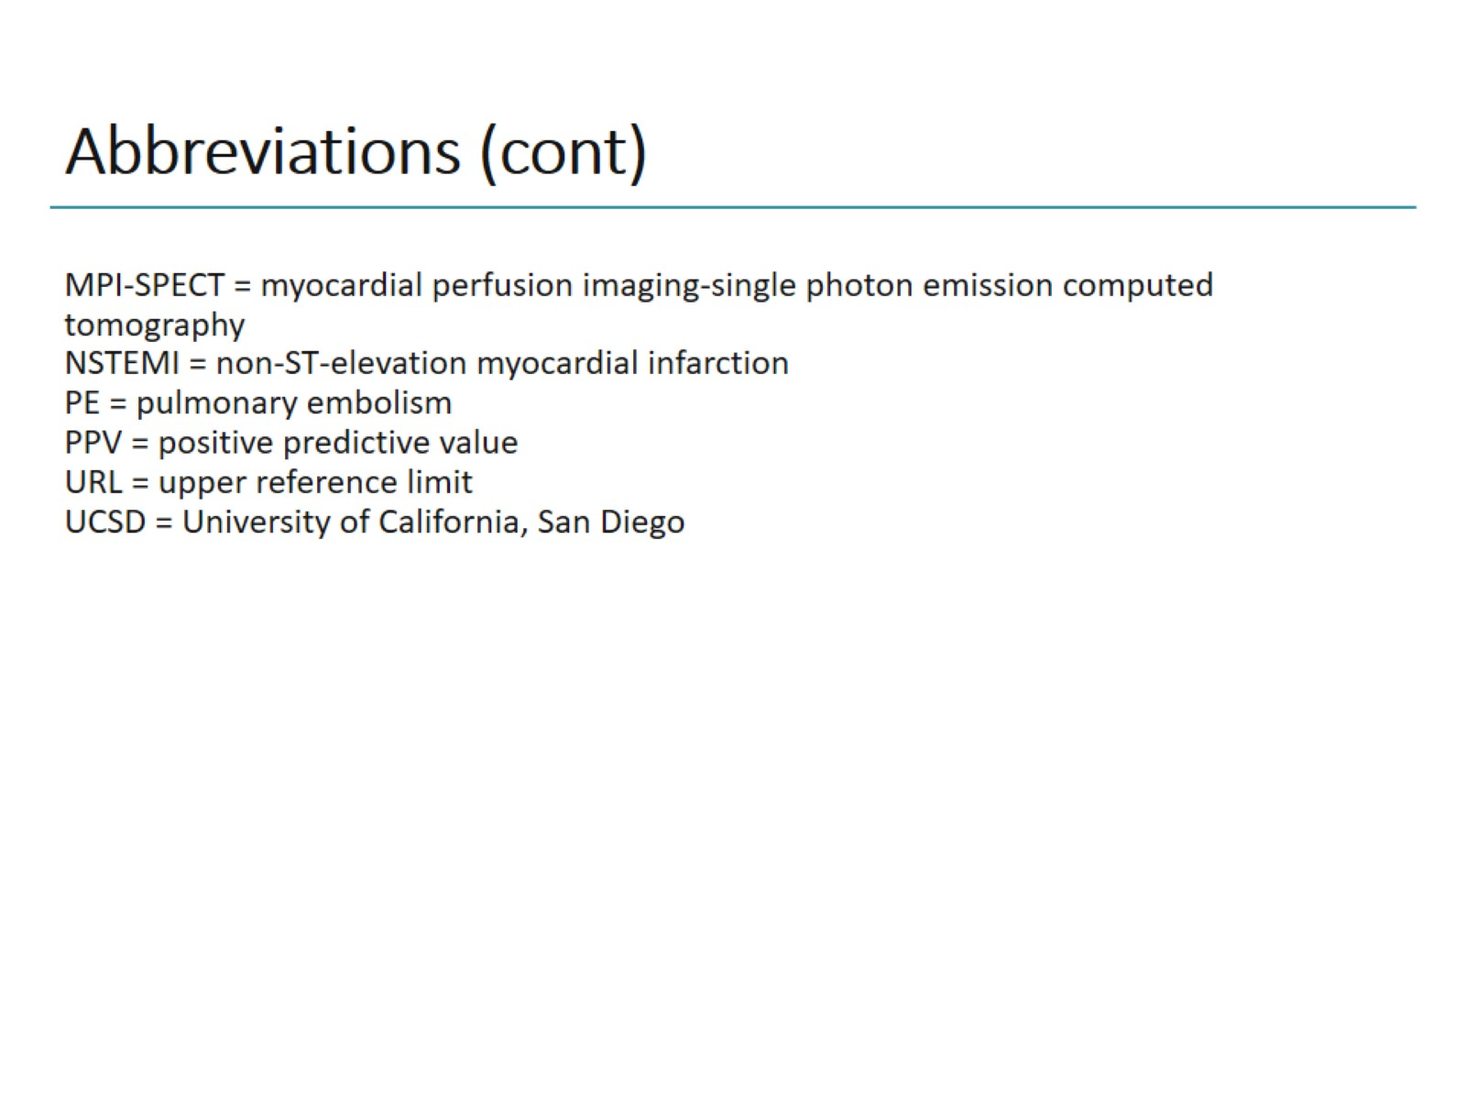
Abbreviations (cont)

